Slide 1

PBL3 Creative Design Project
Ritsumeikan University
Team Agile (Formerly E)
College of Information Science & Engineering
System for Citizen-Centric Human Resource Management in Smart Cities
Andifallih Noor Malela, Yamabe Hiroyuki, Konda Satvik Reddy, Grabowski Jesse Charles, Kathirvel Murugan Sushaant, Tokuyama Hikaru, Lin Jie
1
July 16th 2024

Slide 2
TABLE
OF CONTENTS
I
Introduction
II
Architecture & Implementation
III
Features
IV
Gamification
V
Testing & Limitations
VI
Prototype Demo
2

Slide 3
I. Introduction
System Specifics
“Occupation Explorer”
→ System for a more citizen-centric human resource management
→ Allow to response against evolving career demands and city needs
Citizens use for personal career related tasks
City managers use the system for data-driven human resource management
3
Notes:
add gamification

Slide 4
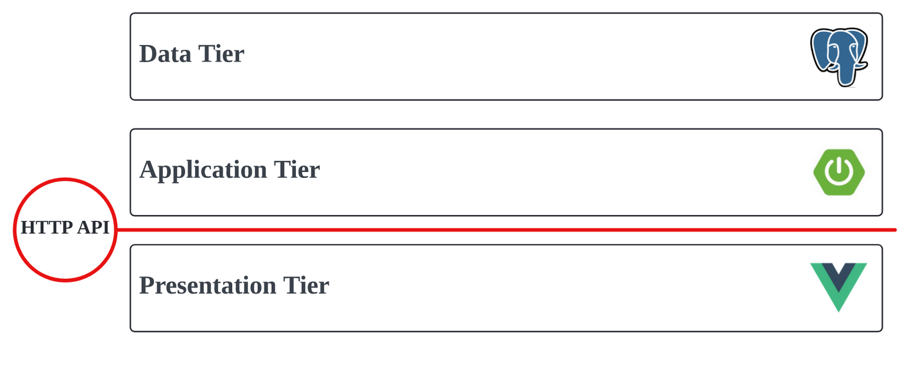

II. Architecture & Implementation
Three-Tier Deployment Architecture
Photo by Brent Keane:
https://www.pexels.com/photo/white-icing-cover-cake-1702373/
4

Slide 5




II. Architecture & Implementation
How we implemented it:
Tools used:
Front-end development
Satvik
Sushaant
Hiroyuki
Back-end development
Andy
Jerry
Hikaru
Jesse
Jesse
Vue.js
Spring Boot
PostgreSQL
Git and GitHub code repository
5

Slide 6

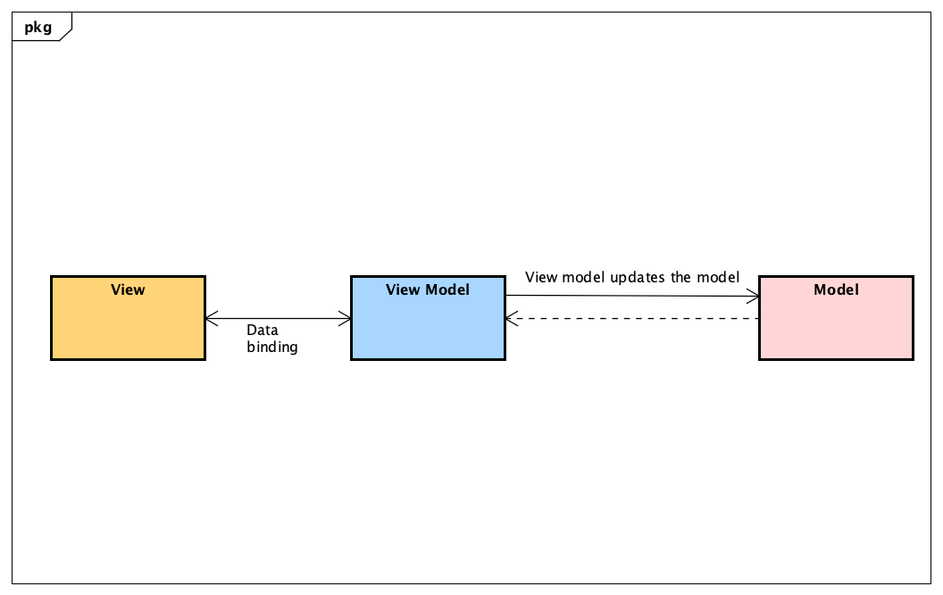
II. Architecture & Implementation
Presentation Tier / Front End Architecture
Component-Based architecture
Image generated with DALL-E
Model View View Model architecture (MVVM)
6

Slide 7
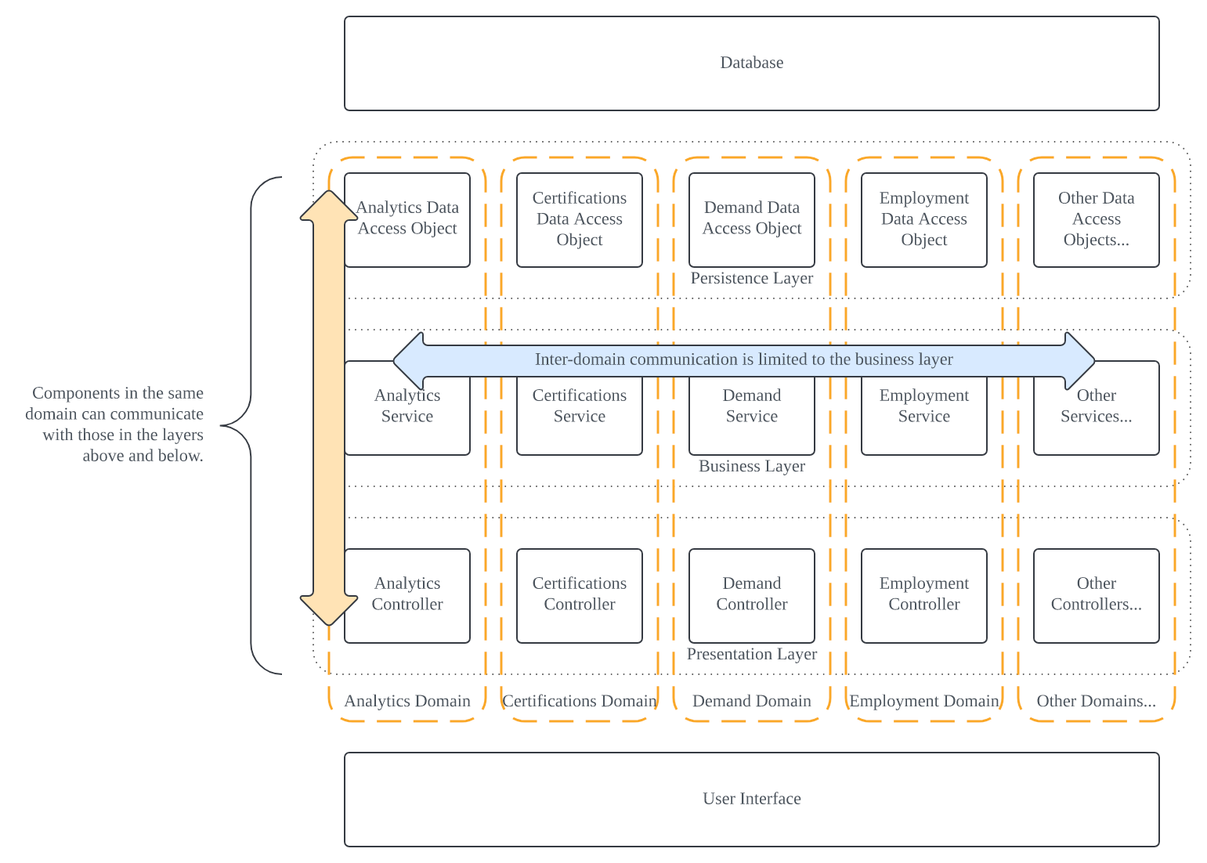

II. Architecture & Implementation
Application
Tier /
Backend
Architecture
7
Photo by Mikhail Nilov on Pexels

Slide 8
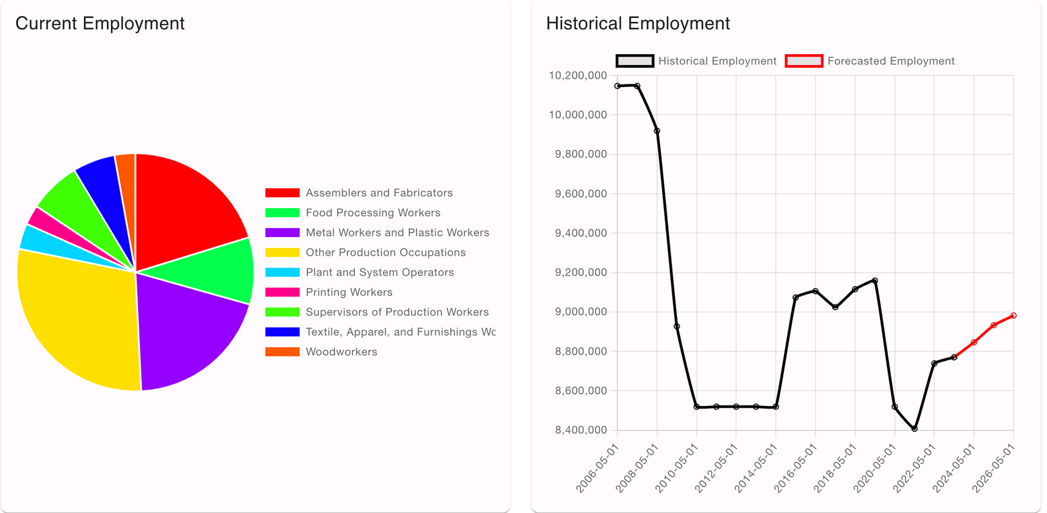
III. Features
Employment
Leverages time series forecasting (ARIMA) to estimate future trends
Smart City Managers can manually input demand to show directional intent
8

Slide 9
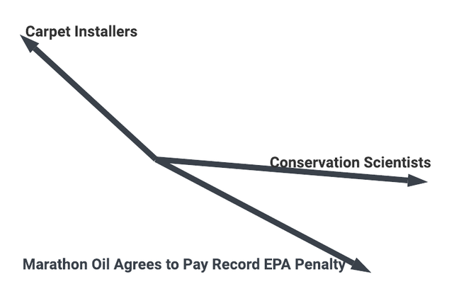
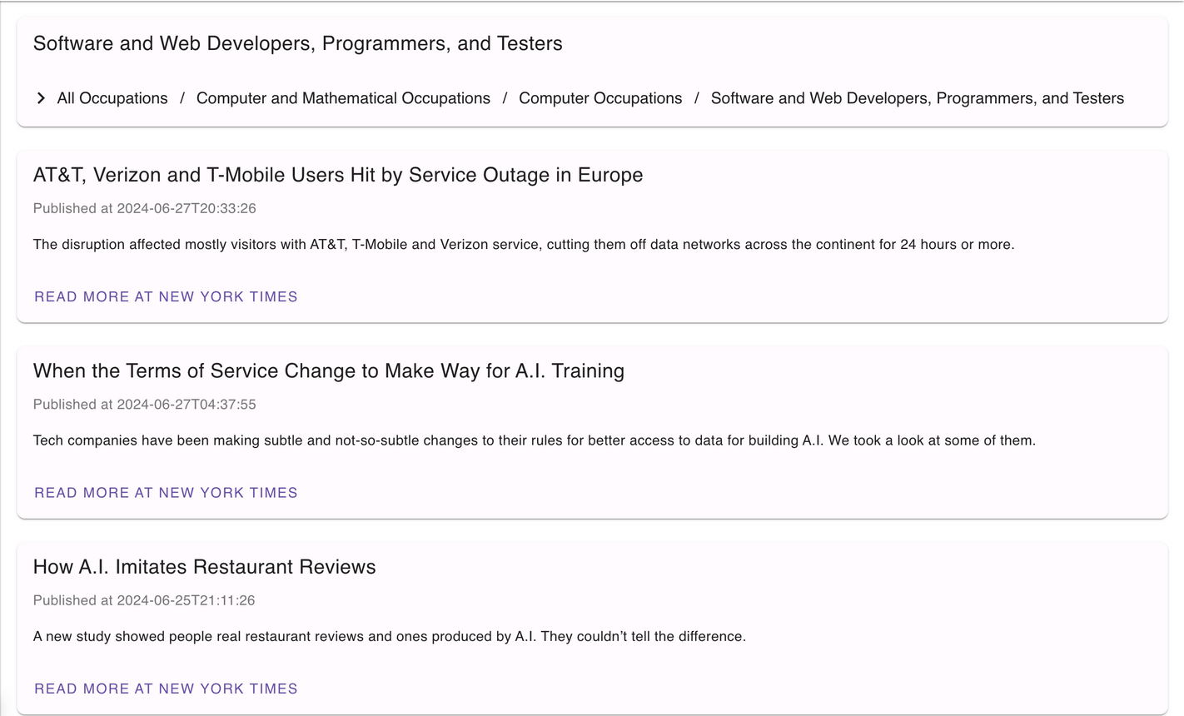
III. Features
News (Word2Vec/Doc2Vec)
Trained doc2vec with 300,000 news articles & company descriptions
Outputs a single vector representing each document (average of the documents’ sentence vectors)
Find cosine similarity with official SOC job descriptions
Compare the news article vector to each SOC description’s vector
Article associated with three nearest SOC vectors
9

Slide 10

III. Features
JobPostings API
Used USAJOBS API to retrieve information about job postings.
Send keywords for the SOC as a free text query
Map response to our job posting format and display on UI
10

Slide 11
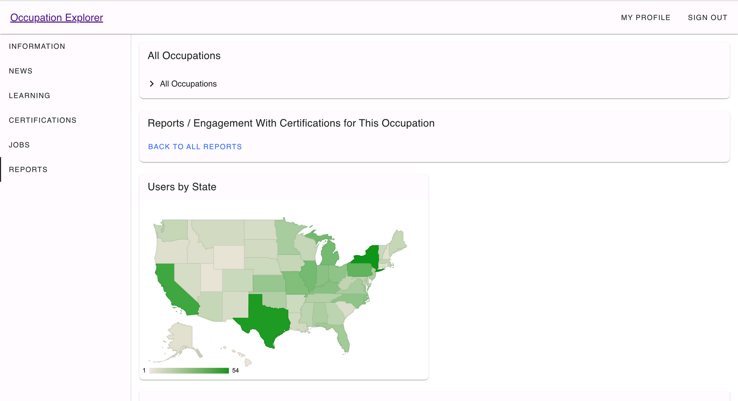
III. Features
Analytics
Collect clickstream analytics as citizens browse the website
Aggregate events by citizen region and current/goal occupations
Render visualizations using Google Charts
11

Slide 12
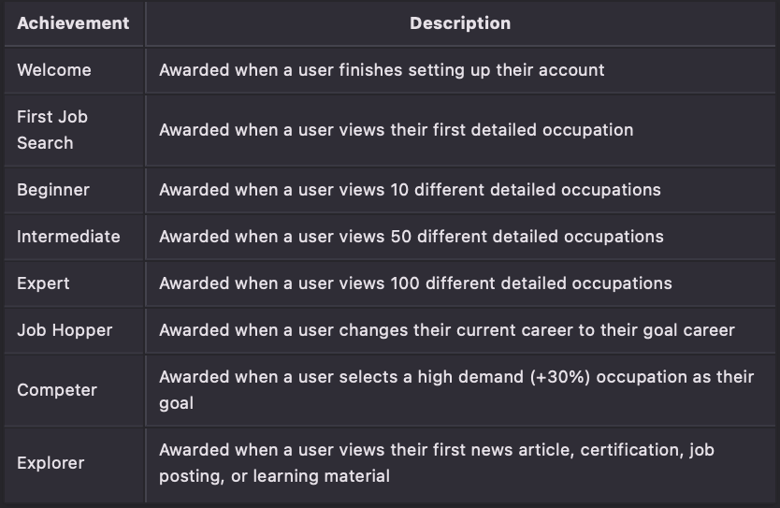
IV. Gamification
Gamification
12

Slide 13
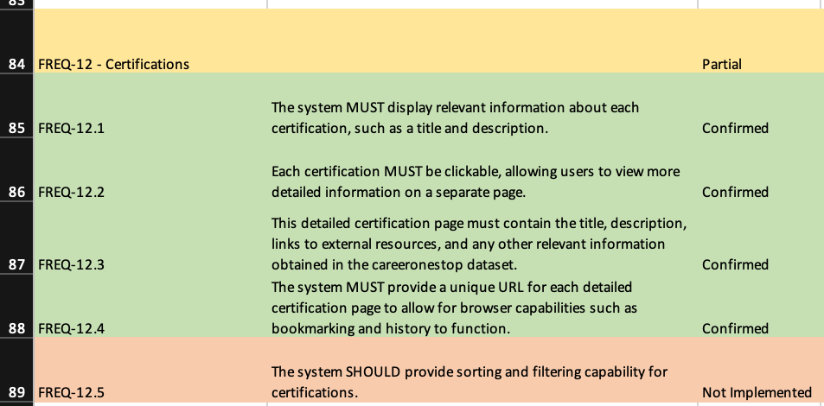
V. Testing and Limitations
Testing and Limitations
Partial release testing, checked each FREQ for completion:
Prototype is missing some reports, data export, and gamification.
Identified bug causing login to fail intermittently
Identified bug where ARIMA would sometimes incorrectly forecast trends
13

Slide 14
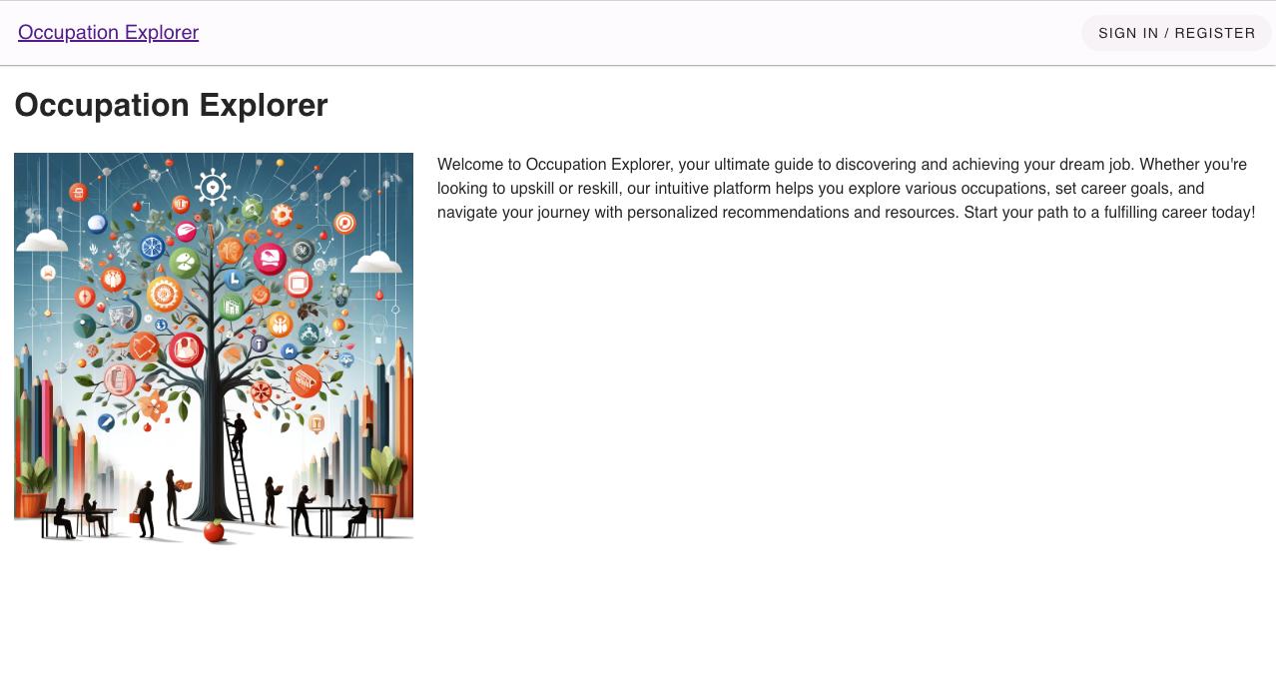
VI. Demo
Prototype Demo
14

Slide 15
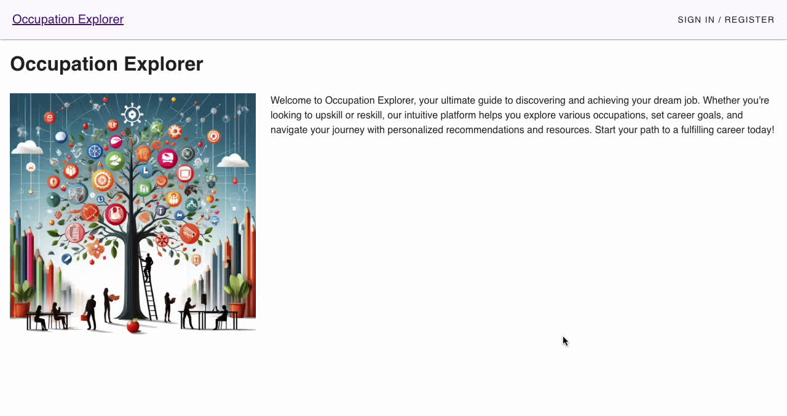
VI. Demo
Prototype Demo
15

Slide 16
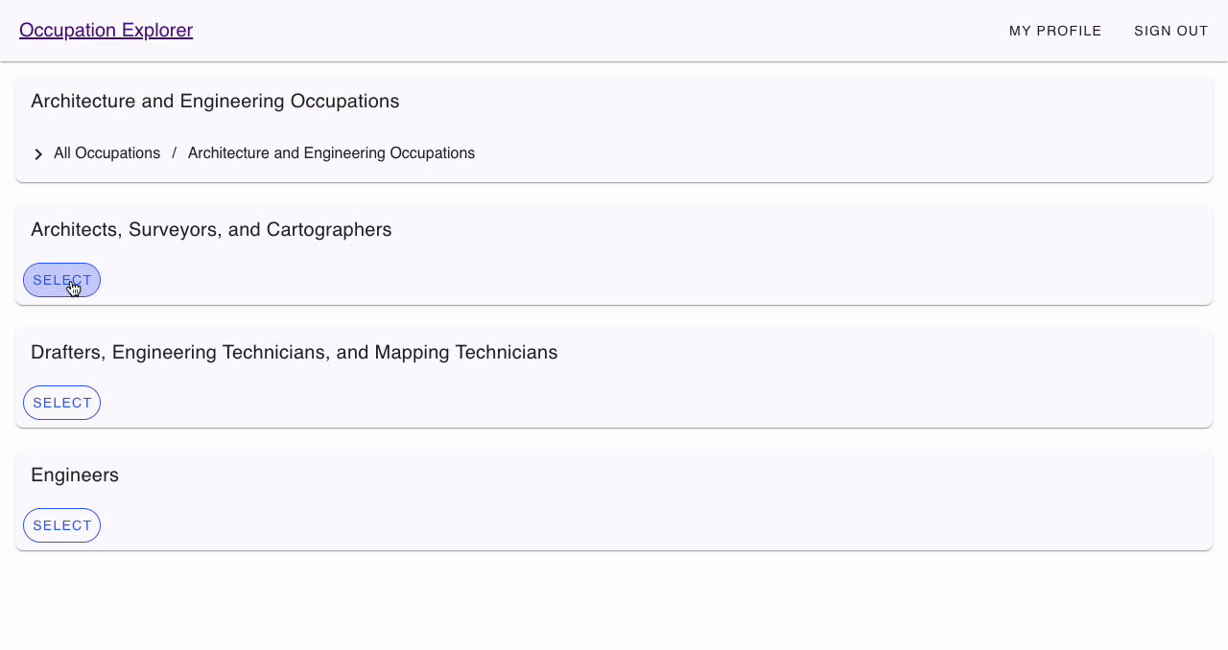
VI. Demo
Prototype Demo
16

Slide 17
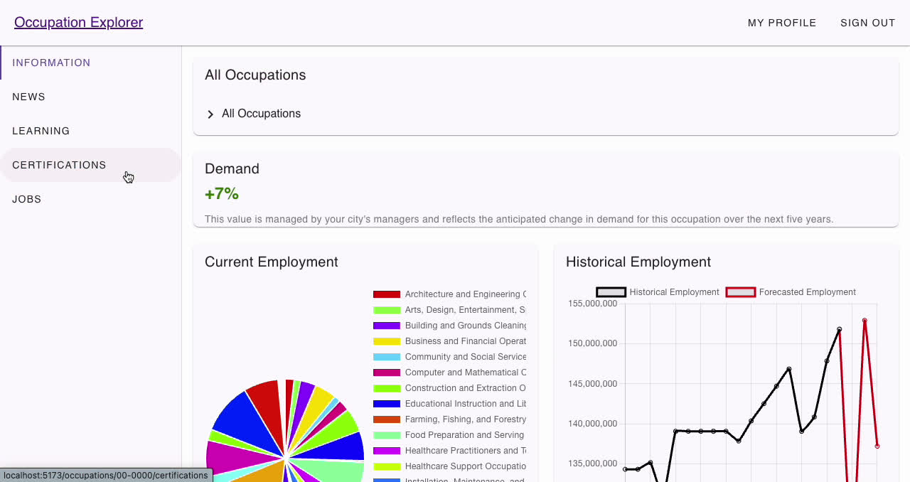
VI. Demo
Prototype Demo
17

Slide 18
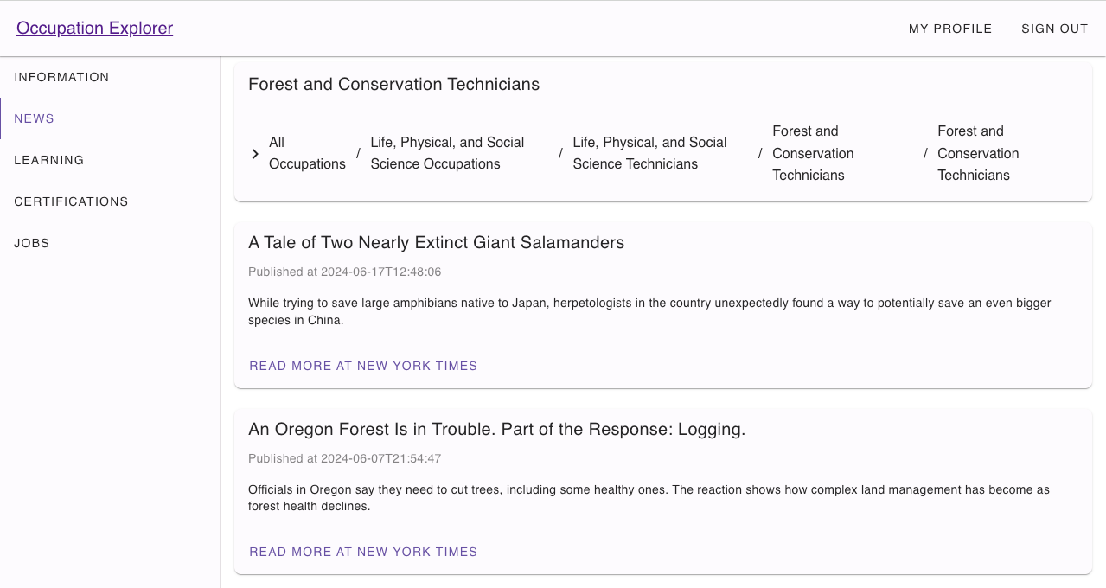
VI. Demo
Prototype Demo
18

Slide 19
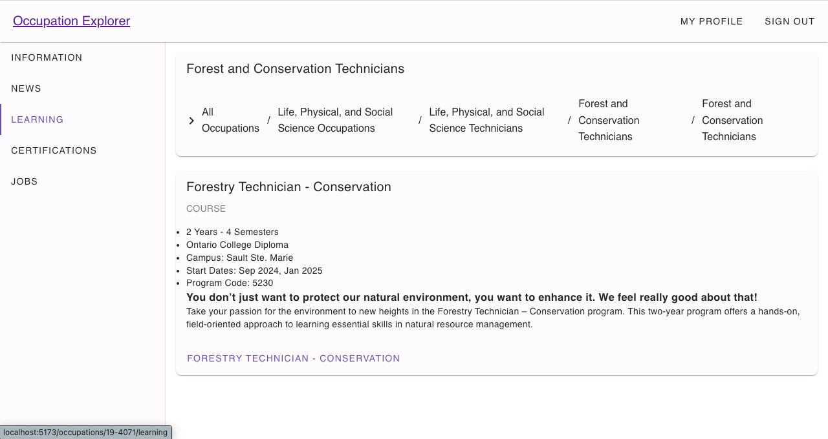
VI. Demo
Prototype Demo
19

Slide 20
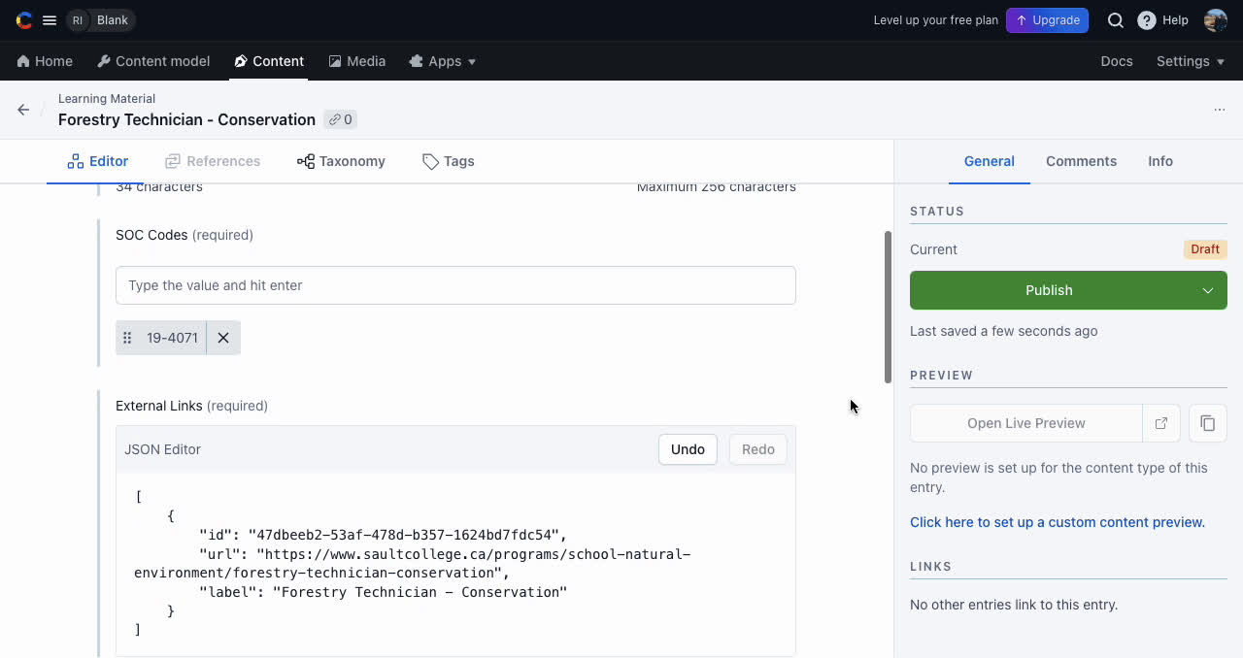
VI. Demo
Prototype Demo
20

Slide 21
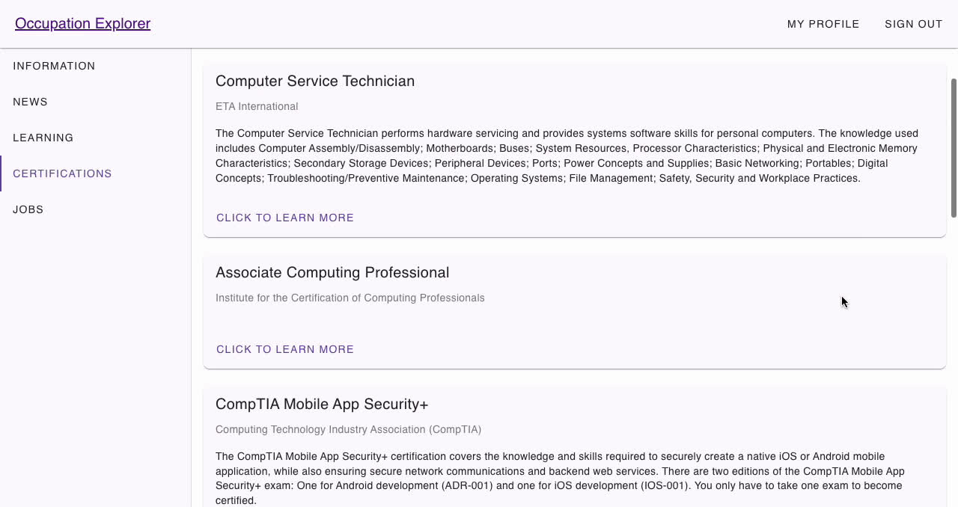
VI. Demo
Prototype Demo
21

Slide 22
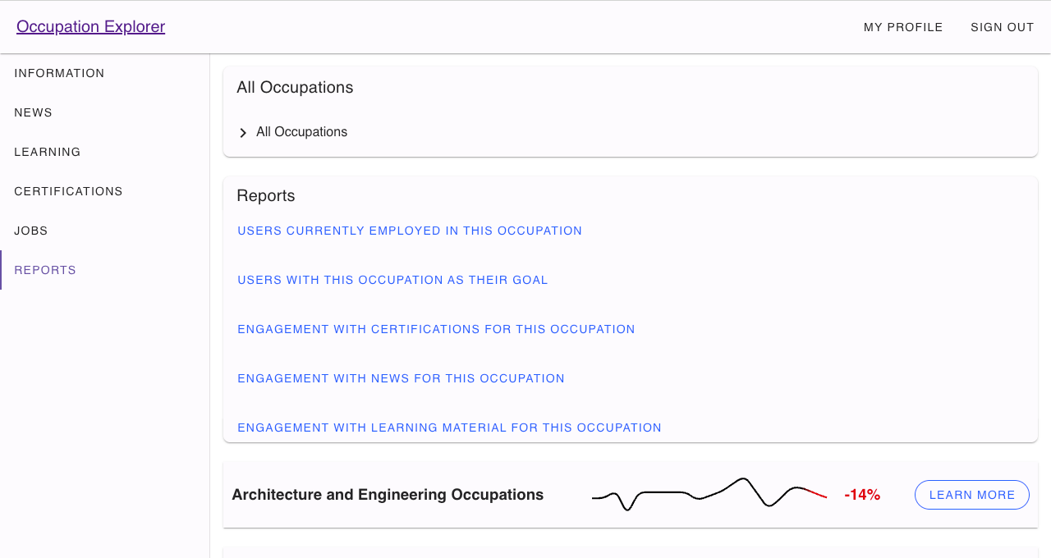
VI. Demo
Prototype Demo
22

Slide 23
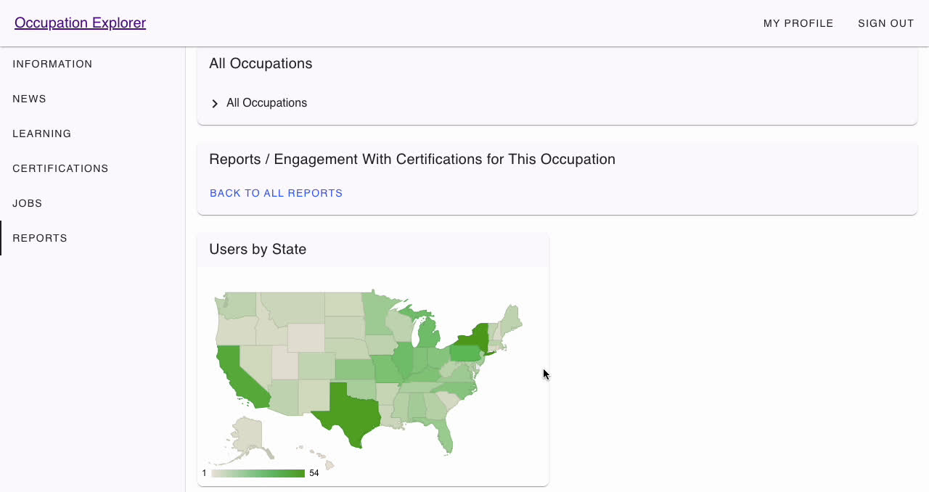
VI. Demo
Prototype Demo
23

Slide 24
Q&A
24

